Slide 1

Chapter 1.3
953321 SOFTWARE REQUIREMENT ANALYSIS: 1-2024
Elicitation
Asst. Prof Dr. Pattama Longani

Slide 2
Requirements Process
1. Inception
2. Elicitation
3. Elaboration
4. Negotiation
5. Specification
6. Validation
7. Requirement Management

Slide 3
INCEPTION vs. ELICITATION
Inception
To define the nature and scope of the system
>> to get perceptions of the system concept
Elicitation
To gather initial requirements for the software
>> to assess FEASIBILITY (possible & value)

Slide 4
You’ve got to built a program/website
before you know what’s in it!!!
Assessing the feasibility
Is it possible to do/finish this ?
Is it worthwhile to do/finish this ?
Does it make (economic) sense ?
What risks are involved ?

Slide 5
Feasibility studies
Scope
Risks

Slide 6
SCOPE
PROJECT SCOPE is a function of
The functionality that must be delivered to meet the user's need
The resources available to the project.
The time and the budget available in which to achieve the implementation.
Features
Stakeholders
Resources
Scope
Time
Cost

Slide 7
1.Feature list
The primary project artifact to manage the scope of the project.
Features are listed before significant investments are made in requirement refinement, design, code, testing, or other project activities.
“if you could do all the features, the prioritization would be unnecessary”
Later, after the prioritization process, the next step is to consider the technical input.

Slide 8
2.Stakeholders
Anyone with an interest in, or an effect on,
the outcome of the product

Slide 9
3.Resources
People: amount / skills
developer
tester
technical writer
quality assurance personnel and
Others
Hardware / Software

Slide 10
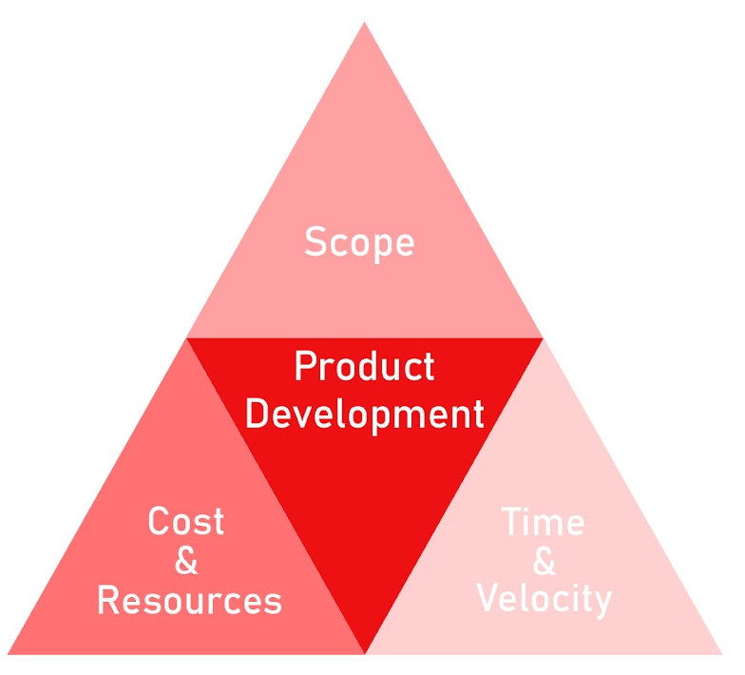
4.Time, 5.Cost
Times have a soft boundary …
that is subject to change
IF the available resources are inadequate to achieve the desired functionality
https://www.monterail.com/blog/the-project-management-triangle

Slide 11
4.Time, 5.Cost
Some project … Time is a FIXED factor
The available resources and budget
… also fixed
BUT the scope (requirement)
… usually NOT fixed

Slide 12
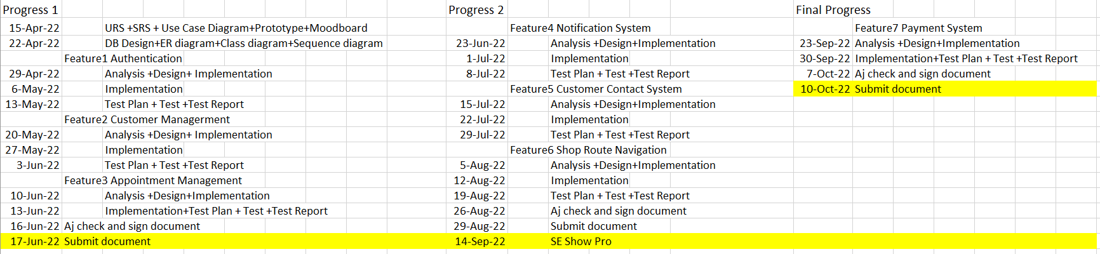
Time

Slide 13
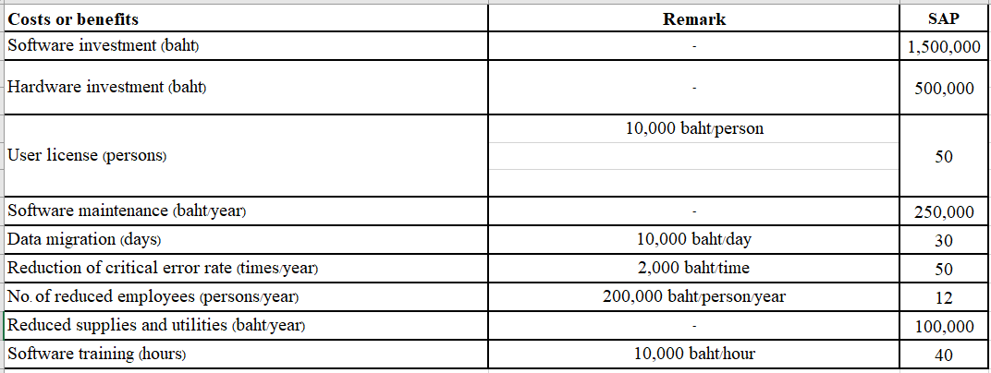
Cost

Slide 14
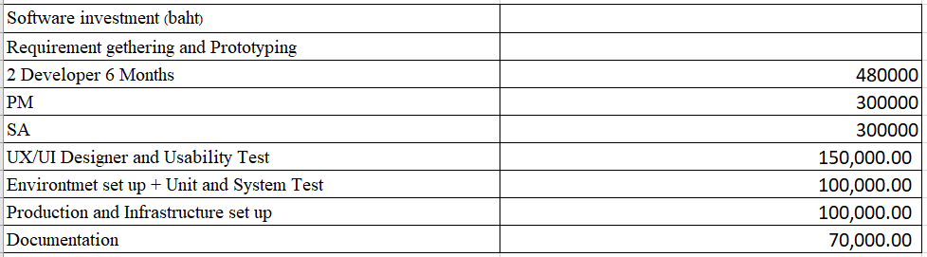
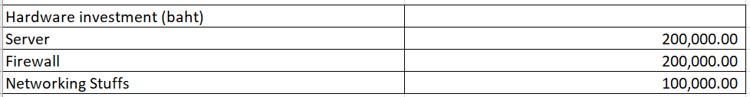

Slide 15
Also include hidden cost:
Electricity
Rental stuffs
Fuel
Telephone charge

Slide 16
Standish group found that
compare between at the start of the project and at the end of the project, How much scope are you typically required to complete by your management, customers, or other stakeholders?.
under 100% answered by a few answers
very from 125% to 500% are responded others
the median and the average is approximately 200%
more than half of all project will cost closely to double of their estimates.

Slide 17
Feasibility studies
Scope
Risks

Slide 18
RISK
Will people use
Worth the invest cost

Slide 19
Risk
Market risk
Will users use our program?
Is our program benefit our organization?
Are there any similar products to us?
Financial risk
Do our organization have enough money to support the program?
How many years that the program will return benefits?
Are there any other choices that our organization will use money?

Slide 20
Risk
Technology risk
Can present technology support our program?
Do we have enough hardware and software?
Will technology will out of date?
Will technology finish before we start to work?
People risk (Stakeholders)
Do we have enough programmer?
Do the programmer have skills we need?
Will CEO support our program?
Do we have good relations with customer?

Slide 21
Risk
Structure/process risk
Will the program change business process of the organization
How many target users will use our program?
How many project related to ours?
Is there any project that the organization have to be completed before us?

Slide 22
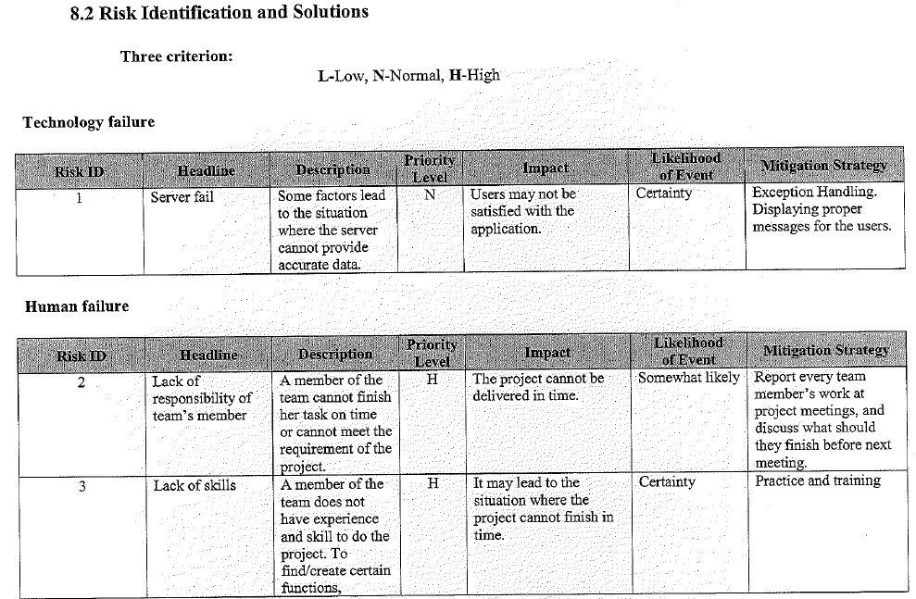

Slide 23
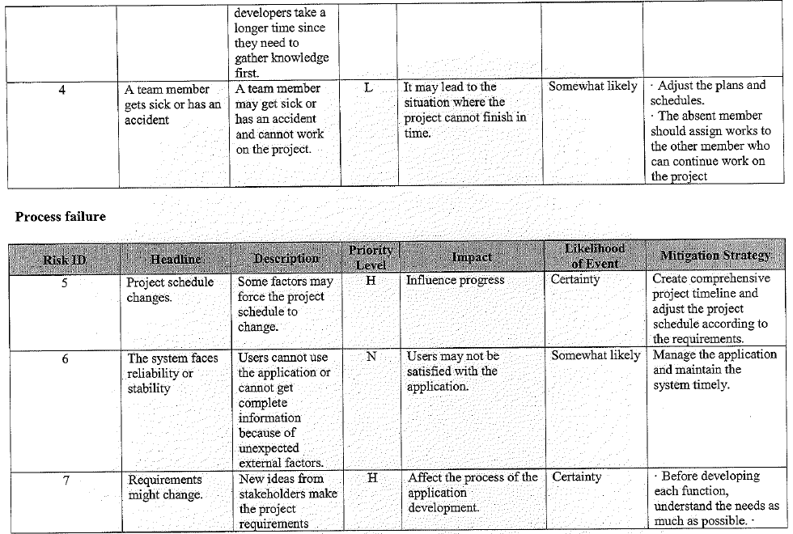

Slide 24
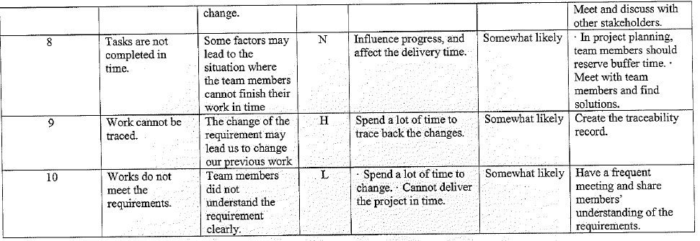

Slide 25
Methods for Reducing Risk
1. Business Review
- Market
- Financial
2. Technology Review
- Advantage, Readiness
- People skills
3. SWOT

Slide 26
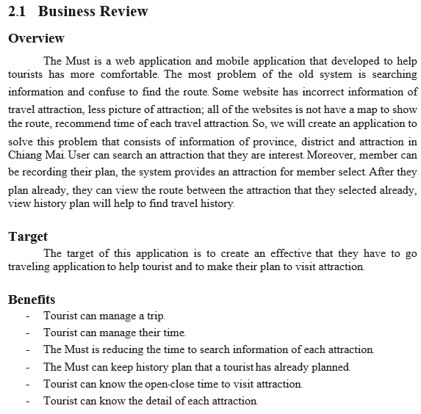
Business Review

Slide 27
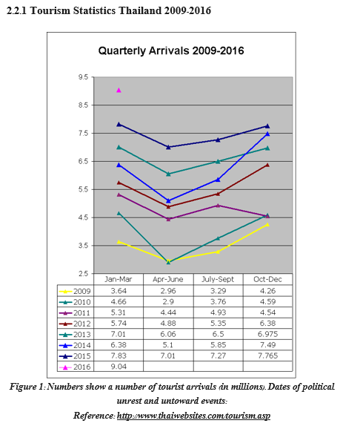
Statistical Support

Slide 28
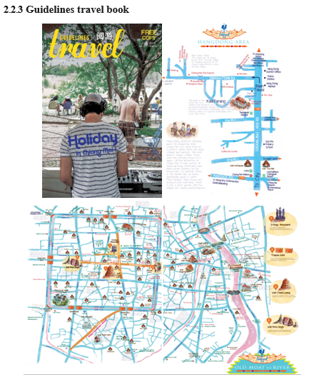
User Behavior

Slide 29

Competitors

Slide 30
Find Pros and Cons of Competitors
The competitors cons have to be more enough, and your web/app pros have to be more enough, so you can beat them and let users who use their web/app turn to use your web/app instead!
Because you want to compare stuffs, visual is help.
A comparison Table would be a choice.

Slide 31
more review, less risk
However,
more review, more time
The best review, go deep into all features of your competitors.
You may need to download and try using their app

Slide 32
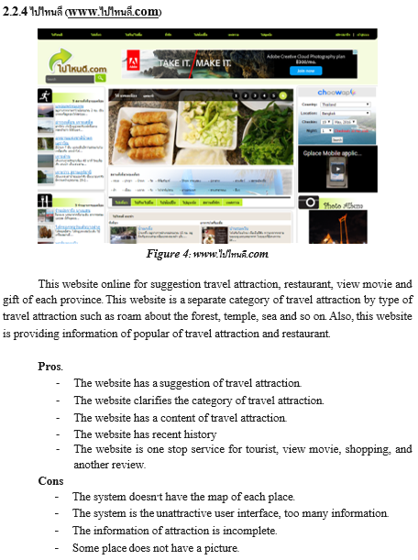
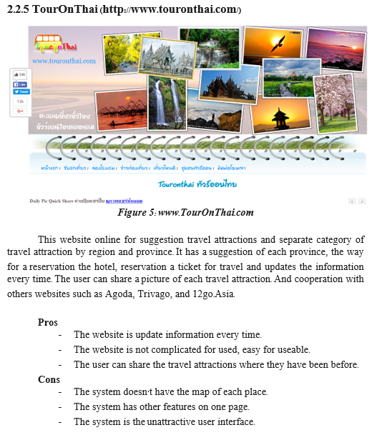

Slide 33
Topic | App A | App B | Your App
1. Free
2. Support both android and ios
3. User can search for a famous location
4. User can save favourite location
5. User can get a recommend travel plan
6. User can get promotion to reduce travel price in each location.
…

Slide 34
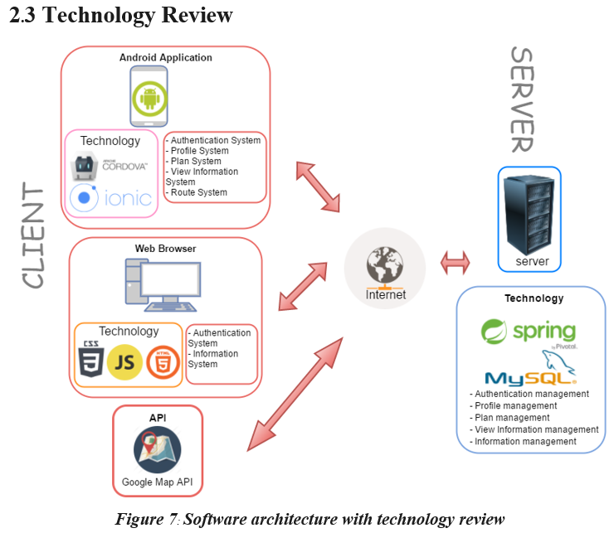
Tools / Software / Technology Review

Slide 35
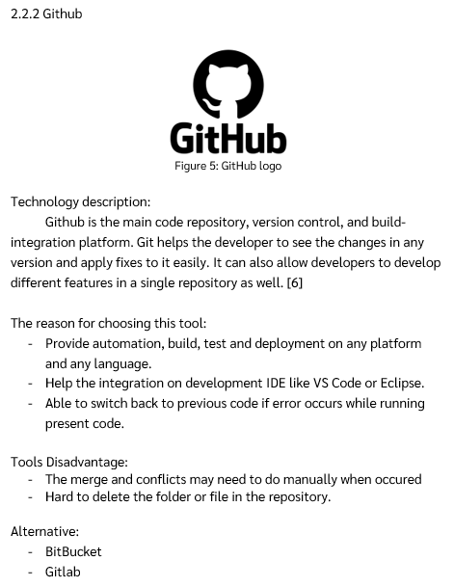
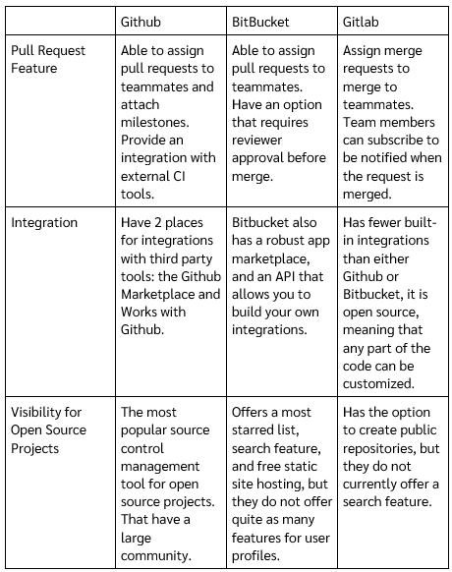

Slide 36
Feasibility studies
Scope
Risks

Slide 37
SWOT
A technique for assessing the four aspects of business
Strengths : inside advantage
Weaknesses : inside disadvantage
Opportunities : outside advantage
Threats : outside disadvantage

Slide 38
Mobile & Web Project Experience
Work on Tools & Use Git
International
Special lecturer
Adaptive & has WIL
Soft skill /Presentation / English
Afraid of Challenge / Training
Not many mobile / UX / UI course
Not many lecturers + Less talk
Unstable Process
Knowledge Transfer Unit
S
W
O
International Student doing Cooperative Education in Thailand
Thai Student doing Cooperative Education in Other country
Company with no mentor / no office
Working hour of other country
More real case project from KIC
More Challenge
Variety special lecturer
Cooperation with many companies
T

Slide 39
Methods for Reducing Risk
1. Business Review
- Market
- Financial
2. Technology Review
- Advantage, Readiness
- People skills
3. SWOT

Slide 40
Requirements Process
1. Inception
2. Elicitation
3. Elaboration
4. Negotiation
5. Specification
6. Validation
7. Requirement Management

Slide 41
Do not invest too much time on these two steps, we have not decided to implement the project!

Slide 42
Next Class – Workshop
Bring your devices
Project topic identification
Business review searching
Define your SCOPE and RISK
Analyze SWOT for your project

